Slide 1
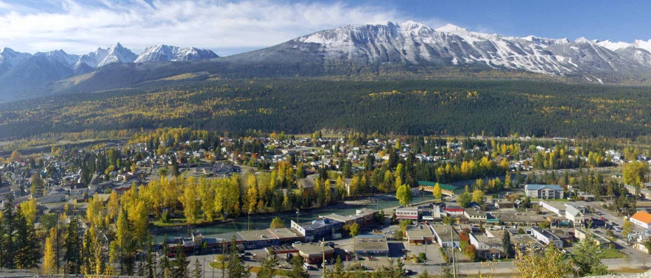
Sport for Life – Golden BC
Welcome to Sport For Life
Authentic. Community. Adventure.
Rec.booking@golden.ca – 250-344-2271 Ext 225

Slide 2
Sport for Life Night
ToG Recreation Services Presents
Sport for Life Night!
With Key Note Speaker – Dave Ellis
Sports Development Consultant & National Team Coach
with a Masters in Kinesiology
Join us for a social event dedicated to everyone in Golden striving to live an active lifestyle. Find out information on interesting developments with the Canadian Sport for Life program and socialize with numerous local active organizations that have the same goals as you.

Slide 3
GCRS’s Community Coordination Project

Slide 4
Community Coordination
Led by Golden Community Resources Society (GCRS)
2010: lack of coordination with community groups
2011: Initiated Phase 1 - ‘Efficiency Exploration’
2012: Phase 1 Findings
over 188 non profits serving Golden & Area A
100+ locally registered
2.5x per capita
Resources spent on general & administrative functions
Outlined efficiency opportunities on GoldenLoom.ca
Includes ‘All Non Profit Organizations’ List → update
Includes research from Golden and other communities

Slide 5
Community Coordination
Phase 2: Develop Community Team/Board
Rationale:
No single decision-making entity/process
Limited human & financial resources must be utilized in an efficient & productive way to improve the quality of life for residents
Continually tightening regulatory changes
Anticipated Outcome:
Coordinated & supported decision-making, planning & resource utilization
Community alignment & economic development
Higher quality of life for residents

Slide 6
Community Coordination
Phase 2: Develop Community Team/Board & Community Coordinator
Current Supporters:
CBT Social Grant Program
Vancouver Foundation (pending)
Town of Golden
Activities:
Capacity & Organizational Development
4Cs: Communication, Coordination, Collaboration & Consolidation
Coalition Support
Involves:
Everyone willing; organizations, government, business, individuals
Timing:
Now
Form Community Team in Fall/Winter (Phase 3)

Slide 7
Community Coordination
Sample Golden & Area A Model
1. Coalitions/Alliances
represent & are
created by
organizations
2. Coalitions feed into Community Team Model
3. Community Team & Coordinator help
align community
Community Team/Board
Child & Family
Youth
Seniors
Health & Social Services
Trails
Funders
Sports & Rec
Arts, Culture, Heritage & Events
Business Organizations
Government
Other
Project Outputs: Coalitions, Survey, Grant Continuum, Community Team’s Terms of Reference, Knowledge Sharing, & Coordinator Job Description.

Slide 8
Community Coordination
For more info:
Ryan Watmough, Consultant/PM
Connie Barlow, Project Sponsor
250-344-8610
nonprofits.gcrs@gmail.com
www.goldenloom.ca

